Slide 1


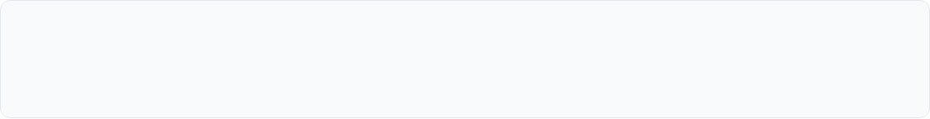
ISBM College of Engineering, Nande, Pune
ACADEMIC YEAR 2026-27 |
Sales and Marketing Agent Development for Online Websites
An AI-Powered Multi-Agent System for Sales, Marketing and Lead Qualification
STUDENT TEAM MEMBERS
PROJECT SUPERVISION
1. Barade Kartik Yogiraj
Guide: Prof. Sangeeta Alagi
2. Kaname Dnyaneshwari Dattatray
Coordinator: Prof. Prajakta Puranik
3. Bangar Sayali Hanumant
HOD: Prof. Kirti Randhe
ISBM College of Engineering, Nande, Pune — Dept. of AI & ML
Slide 1 of 17

Slide 2
Content
Sr.no | Index
1 | Project Concept & Overview
2 | Problem Statement & Motivation
3 | Similar type of methodology
4 | Literature Survey
5 | Project Objectives
6 | System Methodology and workflow
7 | Proposed System Architecture
8 | Autonomous Agent Responsibilities
9 | System Inputs & Outputs Matrix
10 | System UI Implementation & Prototype
11 | Technology Stack & System Specs
12 | Project Review Checklist Alignment
13 | Conclusion
14 | References
Slide 2 of 17

Slide 3
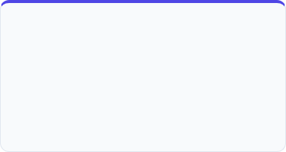
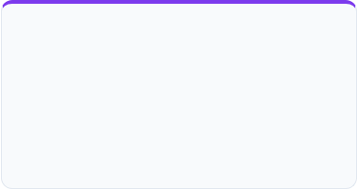
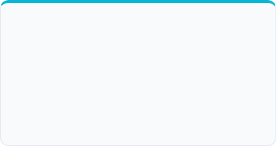



Project Concept & Overview
Concept Statement
An intelligent B2B web system that replaces static forms and generic single-prompt chatbots with specialized, autonomous AI agents powered by LLMs and Retrieval-Augmented Generation (RAG).
Sales Agent
Marketing Agent
Lead Qualification Agent
Handles customer inquiries, provides context-grounded consultation, presents pricing packages, and assists potential leads directly.
Generates targeted promotional content, creates personalized follow-up campaigns, and crafts customized business outreach emails.
Analyzes incoming prospect details, evaluates budget and timeline, scores conversion readiness, and updates CRM tables.
Specialized autonomous agents collaborate seamlessly to deliver end-to-end automation
Slide 3 of 17

Slide 4


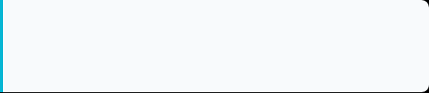
Problem Statement & Motivation
Current Industry Challenges
Concise Problem Statement
Manual handling of technical business inquiries, lead scoring, and campaign copy leads to delayed response times, high operational overhead, and lost sales opportunities.
"To develop an autonomous AI multi-agent web platform that provides domain-grounded pre-sales consultations using RAG, automatically qualifies high-intent leads, and generates personalized marketing campaigns with zero manual delay."
The Rule-Based Chatbot Gap
Reduce Manual Pre-Sales Effort: Automates routine Q&A and qualification.
Traditional rule-based website chatbots provide rigid, generic responses and struggle with multi-turn compliance standards (e.g., ISO 9001, IATF 16949 QMS consulting).
Improve Response Speed: Instant 24/7 technical answers keep leads engaged.
Problem definition aligned with QMS consulting business needs
Slide 4 of 17

Slide 5
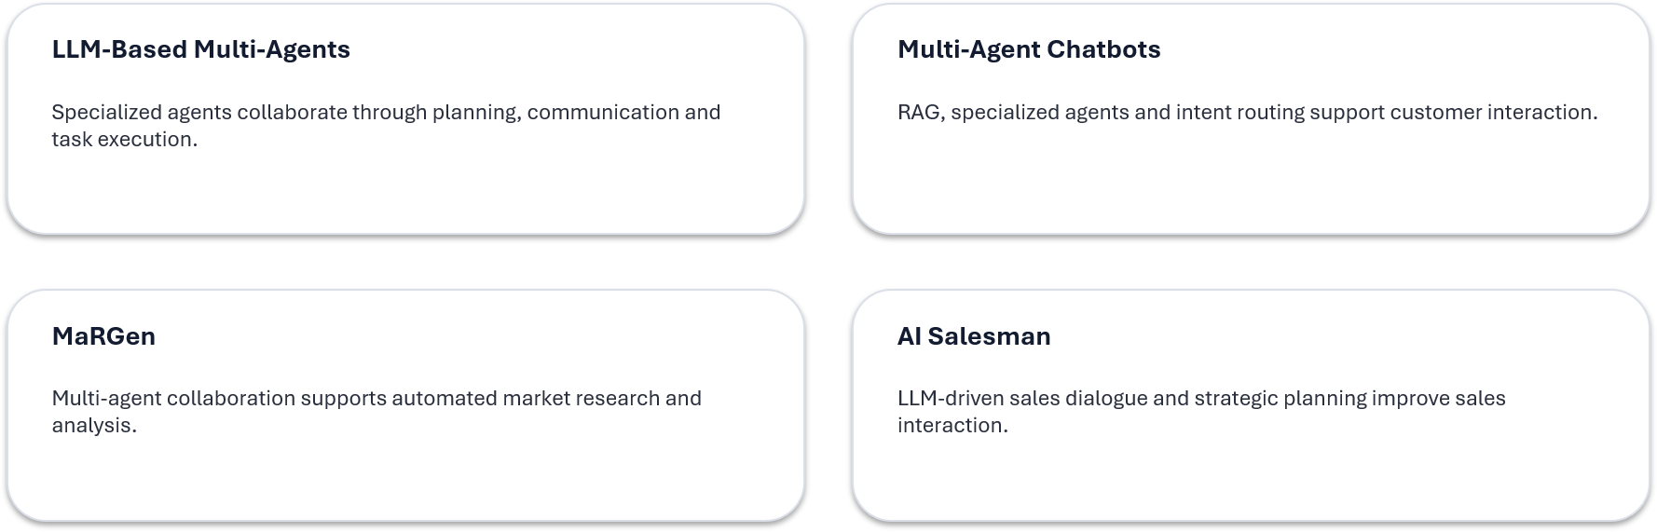
Similar type of methodology
Project direction: combine specialized agents + LLMs + RAG for practical sales, marketing and lead automation.
Similar type of methodology
Slide 5 of 17

Slide 6
Literature Survey
Paper / System Title | Technique Used | Key Takeaway & Relevance
LLM-based Multi-Agents Survey IJCAI 2024 | LLM Planning & Agent Communication | Provides foundation for orchestrating specialized AI agents with discrete functional roles.
Multi-Agent Chatbot Framework ScienceDirect 2026 | RAG & Intent Routing | Demonstrates how RAG prevents LLM hallucinations in complex compliance customer support.
MaRGen: Market Research Agents arXiv 2025 | Multi-Agent Collaboration | Validates automated market data retrieval and personalized campaign content drafting.
AI Salesman: Telemarketing LLM AAAI 2026 | Dialogue Strategy Optimization | Explores structured sales dialogue strategies that guide users towards booking consultations.
LEAD-MAS: Business Lead Intelligence SSRN 2026 | LLM-based Multi-Agent Lead Intelligence & Lead Scoring | Automates business lead discovery, information extraction, lead qualification, scoring, and CRM integration for prioritizing potential customers.
Conclusion: Extensive research literature validates our architecture (Multi-Agent + LLM + RAG + FastAPI).
Literature confirms technological feasibility and validates scope boundaries
Slide 6 of 17

Slide 7
Project Objectives
Objective 1: Multi-Agent Automation
Automate 24/7 web pre-sales consultation and customer interaction using specialized LLM agents.
Objective 4: RAG Grounding
Integrate vector databases to provide accurate, hallucination-free ISO/QMS standards advice.
Objective 2: Lead Qualification
Automatically score incoming prospects based on extracted budget, timeline, and compliance needs.
Objective 5: Centralized CRM Management
Store and sync lead profiles, interaction logs, and analytics into a secure owner portal.
Objective 3: Marketing Content Generation
Generate tailored promotional copy, follow-up emails, and client pitch decks automatically.
Objective 6: Operational Efficiency
Reduce manual human pre-sales workload by over 70% and lower average response times to < 3 seconds.
Objectives are unambiguous, measurable, and aligned with project milestones
Slide 7 of 17

Slide 8
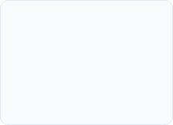








System Methodology & Workflow
Website Query
Intent Routing
RAG Retrieval
Agent Processing
Output & CRM
Visitor submits inquiry via online web chatbot interface.
Classifier routes query to Sales, Marketing, or Lead Agent.
Embeddings match query against ChromaDB knowledge base.
LLM formulates context-aware response or marketing copy.
Delivers answer, updates database, and alerts owner portal.
Methodological Validation
The system decouples user interaction from heavy backend computation. Intent routing ensures queries are processed by the most qualified specialized agent, while RAG restricts answers to verified company documentation.
5-Step structured execution pipeline from client input to owner insights
Slide 8 of 17

Slide 9
Proposed System Architecture
Company Website
Owner Login
Agent Layer
Knowledge Layer
Data
Customer-facing website and AI chatbot.
→
Controlled access to the management environment.
→
Sales • Marketing • Lead Generation
→
RAG + company documents + FAQs
→
CRM / DB
Reports
Autonomous Sales Work
Autonomous Marketing Work
Autonomous Lead Work
Query handling, service guidance, consultation support.
Personalized campaigns, emails and follow-up content.
Requirement extraction, scoring, qualification and prioritization.
Architectural schematic showing user entry points, authentication, and multi-agent hub
Slide 9 of 17

Slide 10

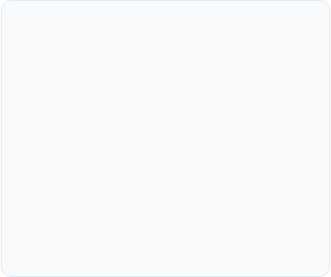
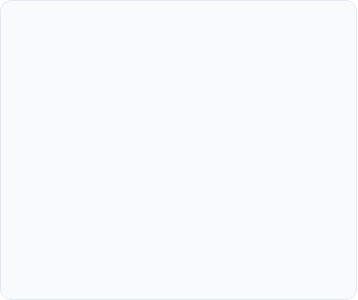



Autonomous Agent Responsibilities
Sales Agent
Marketing Agent
Lead Gen Agent
Answers technical product & compliance standard FAQs.
Creates personalized cold outreach email copy.
Collects user contact details & compliance needs.
Explains service packages & consultancy pricing.
Generates promotional pitch decks & campaign content.
Calculates lead quality & conversion scores.
Guides prospects to book appointment slots.
Analyzes target audience industry profiles.
Updates PostgreSQL / CRM database tables.
Each autonomous agent operates with specialized prompts, memory, and database tools
Slide 10 of 17

Slide 11
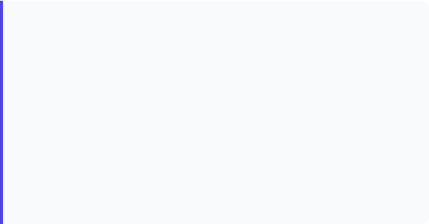
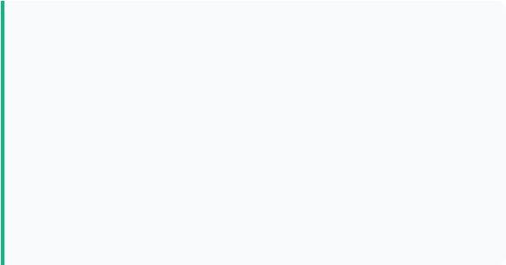
System Inputs & Outputs Matrix
System Inputs
System Outputs
Natural Language Queries: Client questions regarding QMS, ISO certification, and timelines.
Context-Aware AI Answers: Grounded technical answers delivered directly in chat.
Lead Profile Data: Contact name, business email, company size, and budget parameters.
Lead Qualification Summaries: Prioritized score rankings and conversion probability reports.
Knowledge Documents: Company PDFs, service guidelines, ISO compliance standards, and FAQs.
Marketing Campaign Assets: Customized follow-up emails, pitch messaging, and proposals.
Marketing Objectives: Target industry verticals, promotional campaign goals, and tone preferences.
CRM & Analytics Entries: Updated lead tables and scheduled calendar meetings for owners.
Clear mapping of input parameters to generated business artifacts
Slide11 of 17

Slide 12
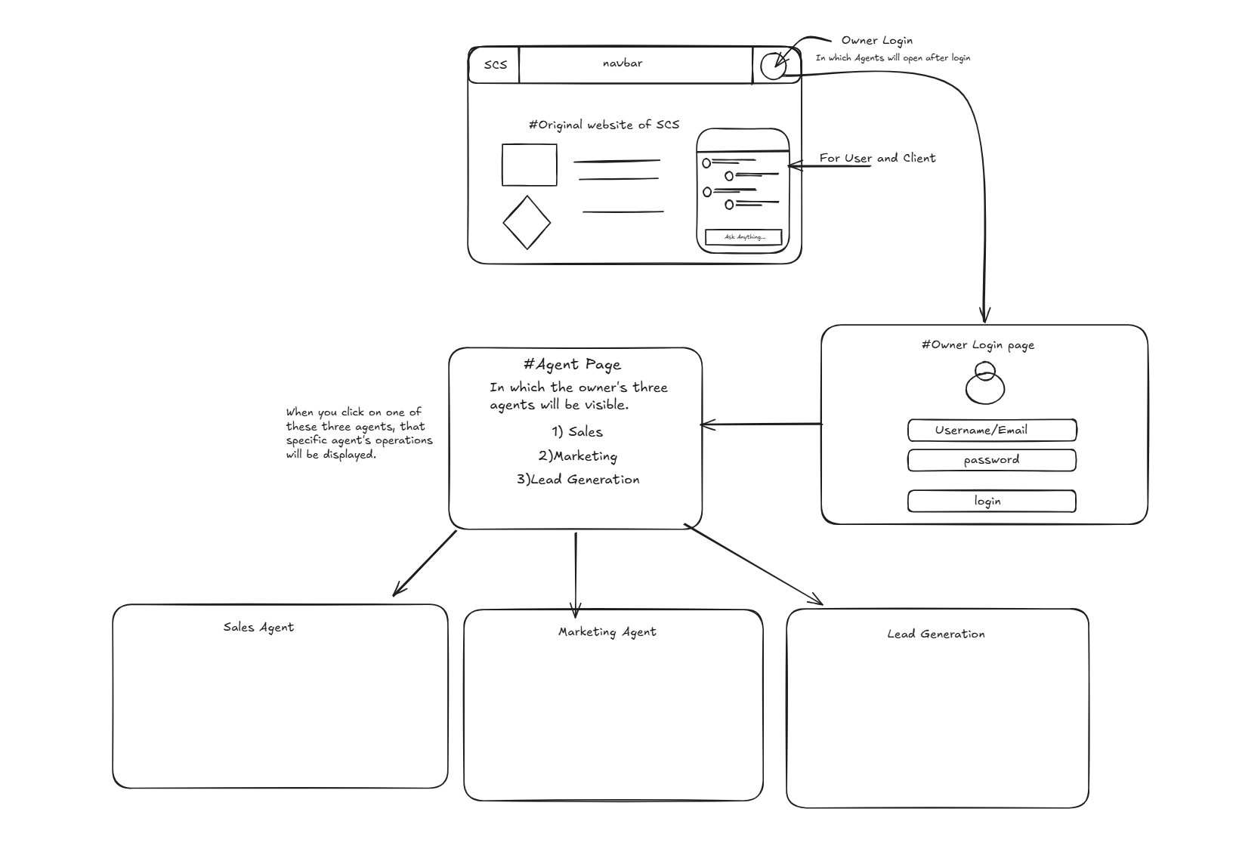
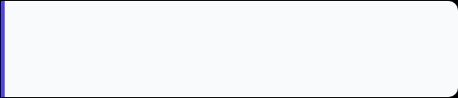

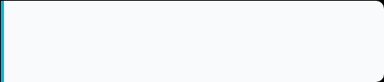
System UI Implementation & Prototype
1. Client Web Chat Widget
Clean modern landing page for Samrath Consultancy featuring an integrated interactive AI Assistant.
2. Owner Portal Login
Secure authentication dashboard allowing business owners to monitor leads and agent operations.
3. Agent Workspace
Real-time pipeline metrics (58 New Leads, 11 Converted) and instant research tools for sales managers.
Functional prototype interface designed for Samrath Consultancy Services
Slide 12 of 17

Slide 13
Technology Stack & System Specs
Software Architecture
Frontend | React.js, HTML5, CSS3, Tailwind CSS
Backend | FastAPI (Python 3.11+)
AI Framework | LangChain, LangGraph / CrewAI
LLM & RAG | OpenAI GPT-4o / Gemini, ChromaDB
Database | PostgreSQL / MongoDB
Developer Tools | VS Code, Postman, Git, GitHub
Operating Specifications
Hardware | Intel i5 (11th Gen+) / 8GB+ RAM / SSD
Security | JWT Token Auth, Password Hashing
APIs | RESTful endpoints, Google Calendar API
Deployment | Uvicorn / Docker Containerized
Browsers | Chrome, Edge, Firefox, Safari
Modular, scalable architecture enabling effortless addition of future specialized agents
Slide 13 of 17

Slide 14



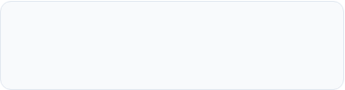
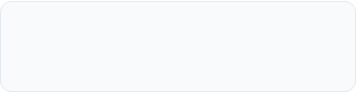
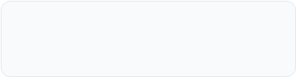
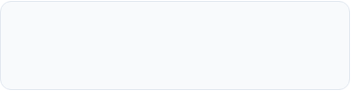
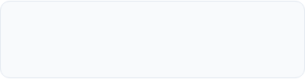
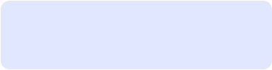
Project Review Checklist Alignment
Q1: Research Gap
Q2-Q3: Problem Statement
Q4: Literature Survey
Identified limitations of static forms and generic rule-based chatbots.
Clear, concise definition of multi-agent pre-sales & marketing automation.
4 recent high-impact publications surveyed (IJCAI, ScienceDirect, AAAI).
Q5: Scope & Survey
Q6: Objectives Alignment
Q7: Scope Clarity
Survey confirms multi-agent RAG architecture is optimal for domain Q&A.
6 unambiguous goals mapped directly to project system deliverables.
Scope bounded to web chatbot, lead qualification, and owner portal.
Q8-Q9: Goal Understanding
Q10: Social Impact
Status Summary
System architecture and agent routing fully planned and documented.
Democratizes ISO compliance and reduces SME manual pre-sales cost.
100% Review-I Criteria Fully Addressed & Cleared.
Comprehensive alignment with Department of AI & ML Project Review-I standards
Slide 14 of 17

Slide 15
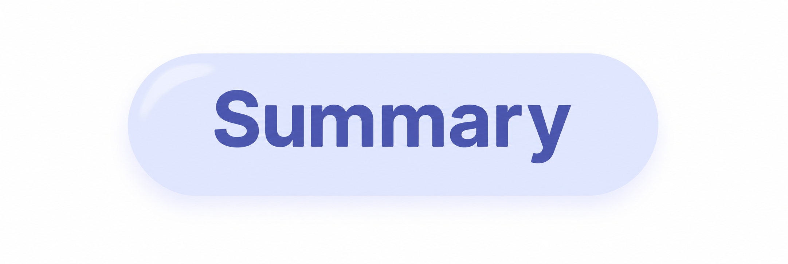
Conclusion
The proposed Sales and Marketing Agent Development for Online Websites aims to make sales and marketing activities easier by using separate AI agents for different tasks. The Sales Agent, Marketing Agent, and Lead Generation Agent can handle their respective work and reduce repetitive manual effort.
The system also uses RAG and company-specific knowledge to provide more relevant responses. With the website, chatbot, owner login, and agent dashboard, the project provides a single platform for managing customer interaction, marketing activities, and leads.
Overall, the project can help make the sales and marketing process faster, more organized, and easier to manage, while also providing scope for future improvements such as CRM integration, analytics, and additional AI agents.
Conclusion
Slide 15 of 17

Slide 16
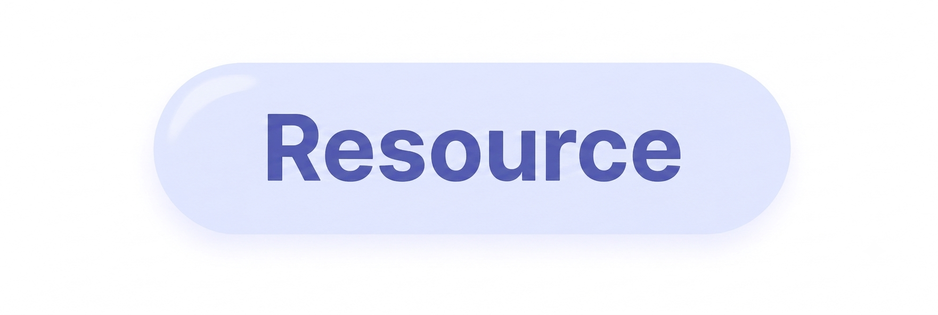
References
1) O. A. Arslan and M. Mete, “Application Level Multi-Agent Methodology for Chatbots,” Procedia Computer Science, vol. 280, pp. 807–815, 2026.
2) T. Guo et al., “Large Language Model based Multi-Agents: A Survey of Progress and Challenges,” Proceedings of the Thirty-Third International Joint Conference on Artificial Intelligence (IJCAI-24), 2024.
3) R. Koshkin et al., “MaRGen: Multi-Agent LLM Approach for Self-Directed Market Research and Analysis,” LLM4ECommerce Workshop at KDD ’25, 2025.
4) A. Panda, B. Das, and N. Singh, “AI-Powered Sales and Marketing Analytics Platform Using Multi-Agent AI,” International Journal of Data Science and IoT Management System (IJDIM), 2026.
References
Slide 16 of 17

Slide 17

Thank You!
Sales and Marketing Agent Development for Online Websites
Final Slide — Academic Year 2026-27
Slide 17 of 17

